Slide 1

Module 8:
Software Verification, Validation and Testing
PART 2
Software Engineering
School of Computing, Faculty of Engineering
Universiti Teknologi Malaysia

Slide 2

Stages of Testing
Commercial software requires 4 stages of testing:
Component test: Individual software components are tested during development to discover bugs and defects
Integration test: Testing is performed between integrated components during development
System test: Separate testing team tests a complete version of the system before it is released to users
Acceptance test: User/customers/authorised entity determine whether to accept the system through formal testing, which is conducted to check whether the system satisfies the acceptance criteria
Rex Black, Erik Van Veenendaal, Dorothy Graham (2012), Foundations of Software Testing - ISTQB® Certification, 3rd ed., Cengage Learning

Slide 3

Stages / Levels of Software Testing
1. Component
2. Integration
a) Alpha
Object/Class
Interface
4. Acceptance
b) Beta
c) UAT
Parameter
Procedural
Message Passing
Top-down
Bottom-up
NF: Stress
NF: Performance
NF: Usability
3. System
Functional

Slide 4

Stage 1: Component Test
Component or unit testing is the process of testing individual components in isolation. It is a defect testing process.
Components may be:
  Individual functions or methods within an object
  Object classes with several attributes and methods
  Composite components with defined interfaces used to access their functionality
Usually, it is the responsibility of the component developer (except sometimes for critical systems)
Tests are derived from the developer’s experience
Types of testing: (i) Object Class Testing (ii) Interface Testing

Slide 5
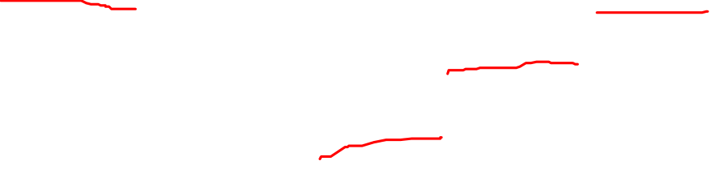
Object Class Testing
Complete test coverage of a class involves:
  Testing all operations associated with an object
  Setting and interrogating all object attributes
  Exercising the object in all possible states

Slide 6


Object/Class Testing Example:
Weather Station Class
Need to define test cases for reportWeather, calibrate, test, startup and shutdown
Using a state model, identify sequences of state transitions to be tested and the event sequences to cause these transitions
Example:
Waiting ➔ Calibrating ➔ Testing ➔
Transmitting ➔ Waiting

Slide 7
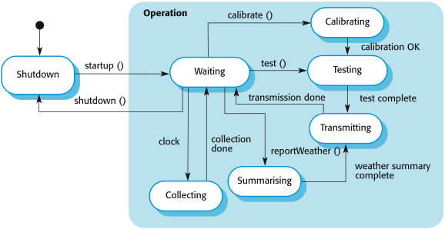
Object/Class Testing Example:
Weather Station Class (Cont.)
From weather class, create the related state diagram:
  Objects have state(s)
  One state transits from another state(s) that is triggered by an event that occurs, certain specific condition and action taken by the object

Slide 8
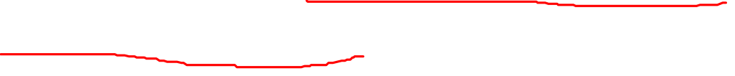
Interface Testing
Objectives are to detect faults due to interface errors or invalid assumptions about interfaces
Particularly important for object-oriented development as objects are defined by their interfaces

Slide 9

Interface Testing Types
Parameter interface
  Data passed from one procedure to another
Procedural interface
  Sub-system encapsulates a set of procedures to be called by other sub-systems
Message passing interface
  Sub-systems request services from other sub-systems

Slide 10
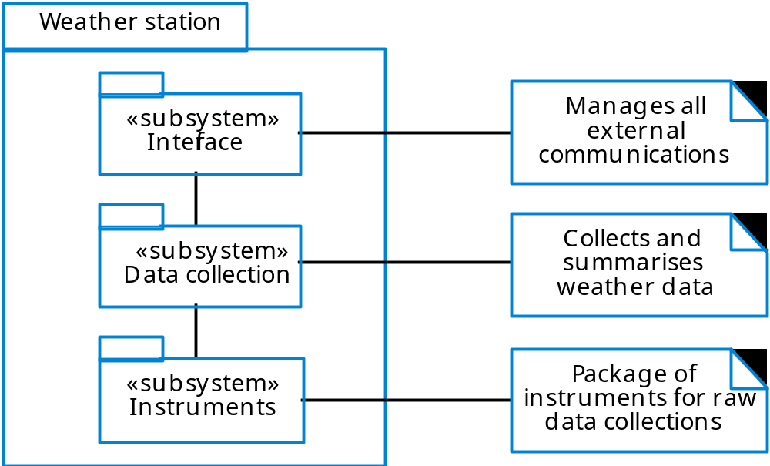
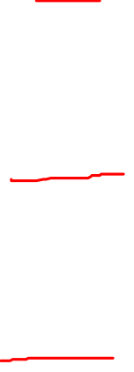
Layered Architecture - 3 Layers

Slide 11
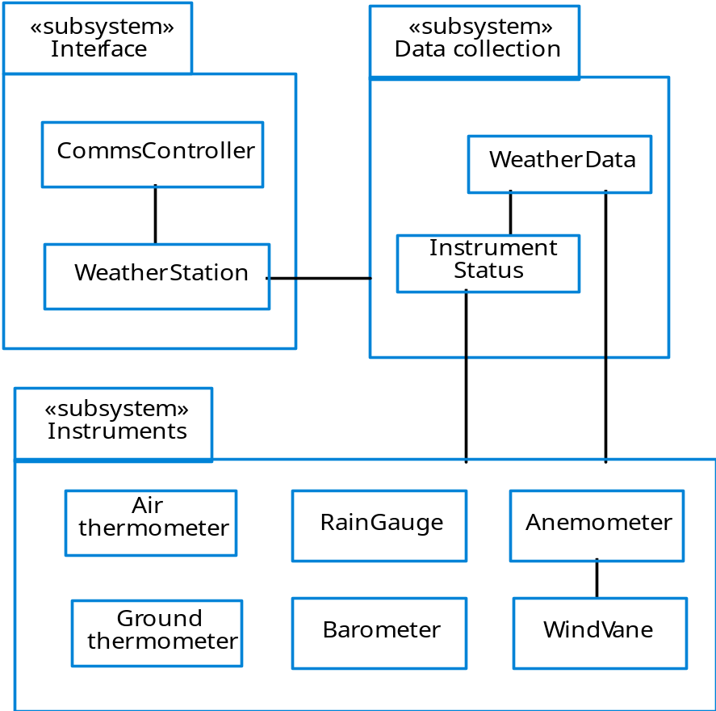
Weather Station Subsystems

Slide 12
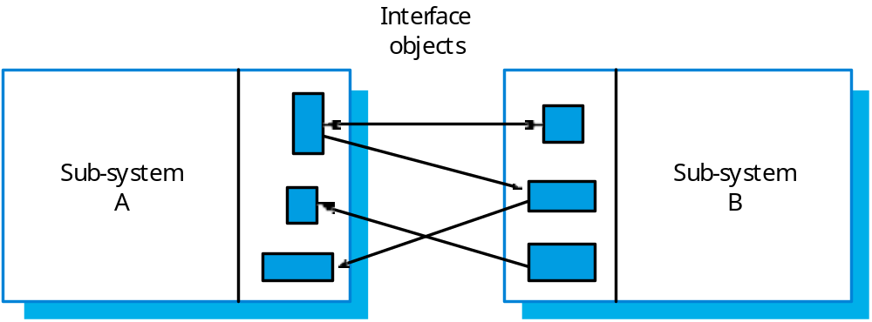
Sub-System Interfaces

Slide 13

Interface Errors
Interface misuse
  A calling component calls another component and makes an error in its use of its interface e.g. parameters in the wrong order
Interface misunderstanding
  A calling component embeds assumptions about the behaviour of the called component which are incorrect
Timing errors
  The called and the calling component operate at different speeds and out-of-date information is accessed

Slide 14
Stages / levels of Software Testing
1. Component
2. Integration
a) Alpha
Object/Class
Interface
4. Acceptance
b) Beta
c) UAT
Parameter
Procedural
Message Passing
Top-down
Bottom-up
NF: Stress
NF: Performance
NF: Usability
3. System
Functional

Slide 15
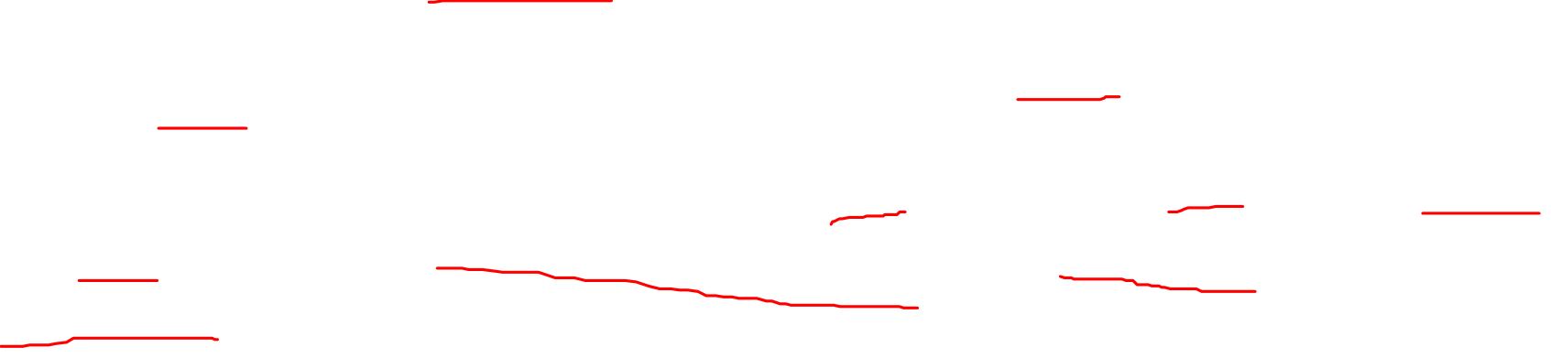
Stage 2: Integration Test
Testing during development involves integrating components to create a version of the system and then testing the integrated system
The test team has access to the system source code and the system is tested as integrated components
The focus in integration test is testing the interactions between components
Integration test checks that components are compatible, interact correctly and transfer the right data at the right time across their interfaces

Slide 16
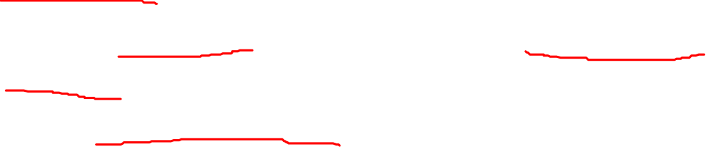
Integration Test (cont.)
Involves building a system from its components and testing it for problems that arise from component interactions:
  Top-down integration:
    Develop the skeleton of the system and populate it with components
  Bottom-up integration:
    Integrate infrastructure components then add functional components
To simplify error localisation, systems should be incrementally integrated

Slide 17
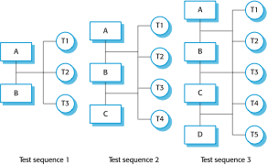

Incremental Integration Testing

Slide 18
Stages / levels of Software Testing
1. Component
2. Integration
a) Alpha
Object/Class
Interface
4. Acceptance
b) Beta
c) UAT
Parameter
Procedural
Message Passing
Top-down
Bottom-up
NF: Stress
NF: Performance
NF: Usability
3. System
Functional

Slide 19

Stage 3: System Test
Process of testing an integrated system to verify that it meets specified requirements
The test team (preferably independent testing team) test the complete system to be delivered as a black-box
Includes function test, function interaction (flow) and non-functional attributes
Three examples of system testing to test non-functional attributes:
  Stress testing
  Performance testing
  Usability testing

Slide 20
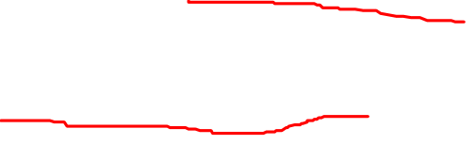
System Test (cont.)
The process of testing is a release of a system that will be distributed to customers
Primary goal is to increase suppliers’ confidence that the system meets its requirements
System test is usually black-box or functional testing:
  Based on the system specification only
  Testers do not have knowledge of the system implementation
  (see requirements test section later)

Slide 21
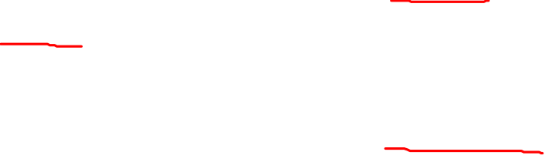
Stress Testing
The application is tested against heavy load e.g. complex numerical values, large number of inputs, large number of queries etc. which checks for the stress/load the applications can withstand
Example: Developing software to run cash registers
  Non-functional requirement:
    “The server can handle up to 30 cash registers looking up prices simultaneously.”
  Stress testing:
    Occur in a room of 30 actual cash registers running automated test transactions repeatedly for 12 hours

Slide 22
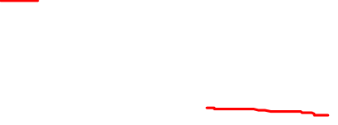
Performance Testing
Part of release testing may involve testing the emergent properties of a system e.g. performance and reliability
Example:
  Performance requirement:
    “The price lookup must complete in less than 1 second”
  Performance testing:
    Evaluates whether the system can look up prices in less than 1 second (even if there are 30 cash registers running simultaneously)

Slide 23
Usability Testing
Testing is conducted to evaluate the extent to which a user can learn to operate, prepare inputs for and interpret outputs of a system or component
Usually done by human-computer interaction specialist that observe humans interacting with the system

Slide 24
Stages / levels of Software Testing
1. Component
2. Integration
a) Alpha
Object/Class
Interface
4. Acceptance
b) Beta
c) UAT
Parameter
Procedural
Message Passing
Top-down
Bottom-up
NF: Stress
NF: Performance
NF: Usability
3. System
Functional

Slide 25
Stage 4: Acceptance Test
Formal testing with respect to user needs, requirements, and business processes conducted to determine whether or not a system satisfies the acceptance criteria and to enable the user, customers or other authorized entity to determine whether or not to accept the system
Customers test a system to decide whether or not it is ready to be accepted from the system developers and deployed in the customer environment, primarily for custom systems
Goal is to establish confidence in the system/part-system or specific non-functional characteristics (e.g. performance), usually for ensuring the system is ready for deployment into production

Slide 26

Acceptance Test (cont.)
Acceptance test is a stage in the testing process in which users or customers provide input and advice on system testing
Acceptance test is essential, even when comprehensive system testing have been carried out
The reason for this is that influences from users’ working environment have a major effect on the reliability, performance, usability and robustness of a system
These cannot be replicated in a testing environment

Slide 27

Acceptance Testing Process

Slide 28
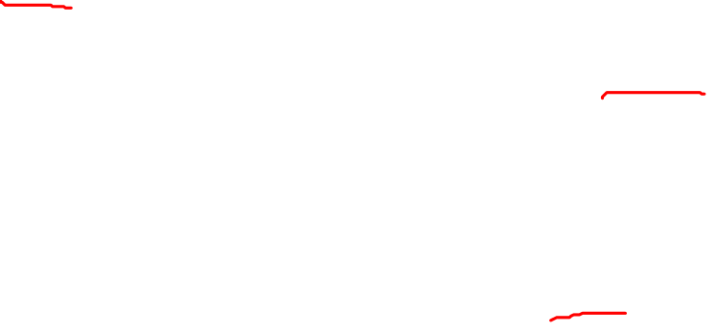
Types of Acceptance Test
Alpha testing
  Users of the software work with the development team to test the software at the developer’s site
  In-house test
Beta testing
  Early testing of stable product by customers / users
  A release of the software is made available to users to allow them to experiment at their site and to raise problems that they discover with the system developers
  published reviews of beta release test results can make or break a product (e.g. PC games)
User Acceptance Testing (UAT)
  Conducted by or visible to the end user & customer at the final stage of validation
  Testing based on the defined user requirements which often uses the ‘thread testing’ approach – the same ones for functional system test

